Slide 1
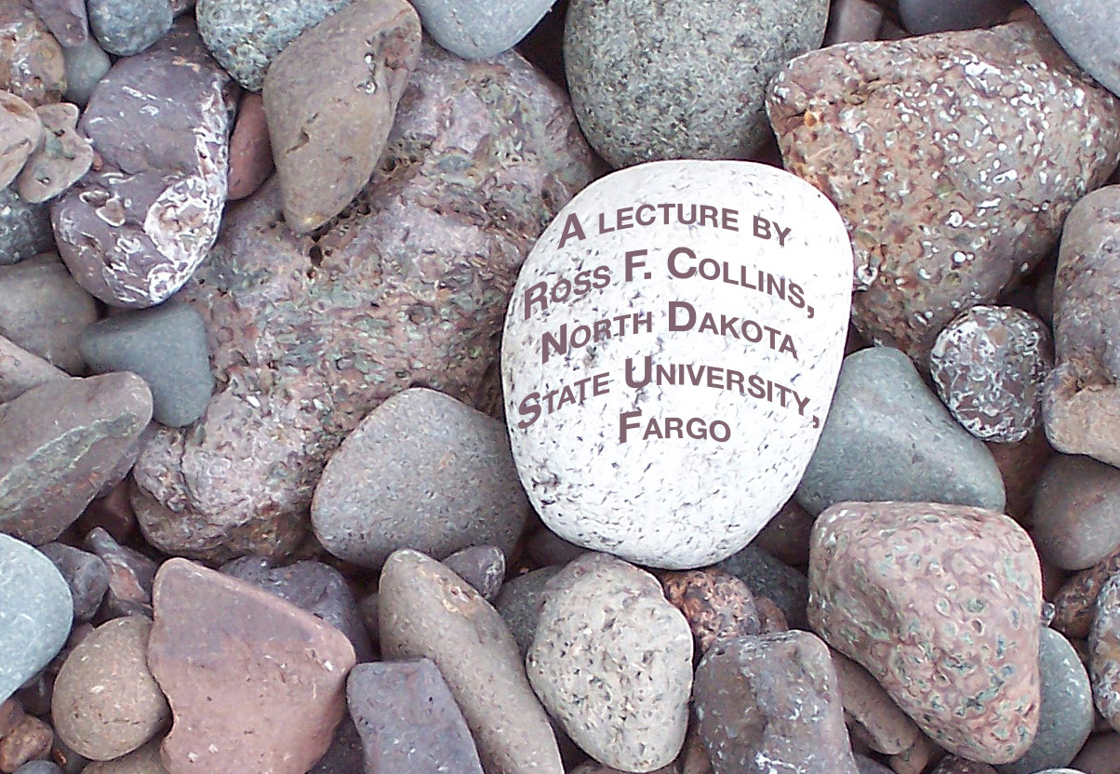
Light
and photography

Slide 2
We take light for granted
If we have enough to see, most of the time we don’t consider its quality or direction.

Slide 3
Light to photographers
Photographers, on the other hand, instinctively consider the characteristics of light.
We can compare this to musicians who analyze music where ever they go.

Slide 4
Photography=“light writing”
We learn in this class to “write with light.”
It took many centuries for people to really understand the nature of light.

Slide 5
Nature of light
For centuries people thought light traveled from the eye to an object, and back.
People assumed dark was as much a characteristic as light. You could “cast darkness” on something.

Slide 6
Nature of light
Today we know dark is merely an absence of light.
Yet visually dark does have a powerful presence in our world and in photographs.

Slide 7
Physics of light
Light theory today says light behaves sometimes like particles, sometimes like waves.
It is part of a much larger electromagnetic spectrum.

Slide 8
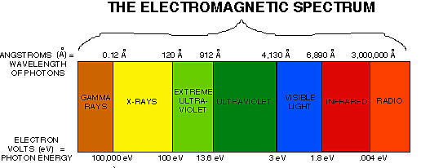
Electromagnetic spectrum
The spectrum includes infrared, ultraviolet, radio, xrays, all of which we can’t detect.

Slide 9
Light as waves
As waves, light has a “crest” like waves in water. But it also moves from side to side.
The distance between each crest is called a wavelength.

Slide 10
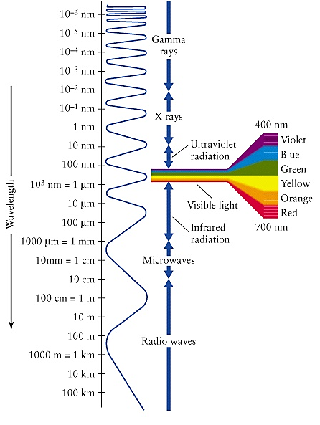
Wavelength size
Wavelengths vary from 1/2,500,000,000,000 of an inch (gamma rays) to miles (some radio waves).
Visible light wavelengths are about 1/4,500,000 of an inch.

Slide 11
Visible spectrum
At the long end of th visible spectrum are the reds. Infrared can’t be seen but can be picked up by some sensors and film.

Slide 12
Visible spectrum
At the short end of the visible spectrum are the blues and violets. Ultraviolet can’t be seen but can be picked up by sensors and film as haze. Filters can reduce this effect for more clear landscape photos.

Slide 13
White light
All colors of the spectrum combine to what we call “white light.”
But most white light has a dominant wavelength. We see that as a color cast.

Slide 14
Color balance
The dominance of certain colors within white light is called color balance.
It is measured in color temperature, using the Kelvin scale.

Slide 15
Kelvin scale
Color temperature of light on a sunny day is 5,500 degrees K. This is slightly blue-dominant.

Slide 16
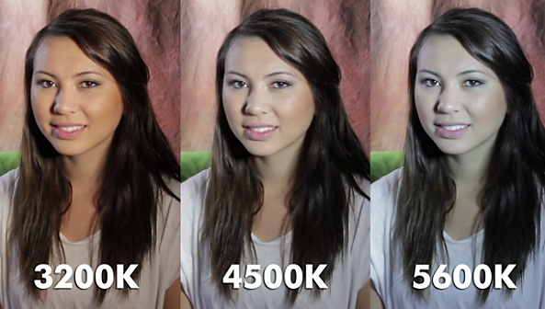
Kelvin scale
At the lower end, color temperature of a light bulb may be 2,500 degrees K.

Slide 17
White balance
A digital camera’s white balance system tries to correct for this.
Color film is balanced for a particular color temperature.

Slide 18
Missing wavelengths
Some “white” light is actually missing parts of the color spectrum.
Florescent light, for example, if unadjusted is missing parts of the warmer side of the spectrum.

Slide 19
Light direction
Light coming from a source such as the sun emits rays going straight in all directions.
When these rays hit something, they either reflect or bend (refract).

Slide 20
Light direction
Reflection is at the same angle, just as a billiard ball on a table.
This is important if a photographer wants to bounce a flash off a ceiling or wall.

Slide 21
Light directions
Some light rays are also absorbed by an object.
The wavelengths absorbed determines the color of an object.

Slide 22
Light absorbed
If an object is white, it reflects nearly all light rays.
If an object is black, it absorbs nearly all.
The more an object absorbs light energy, the more it heats up.

Slide 23
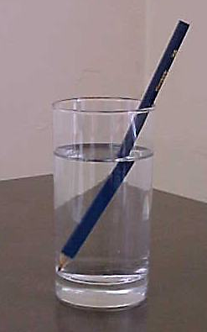
Refraction of light
Refraction, or bending, is easily seen as sunlight entering a pool or glass of water.
Refraction also is the principle behind the camera lens.

Slide 24
Characteristics of light
Photographers consider three basic aspects of light:
intensity.
quality.
direction.

Slide 25
Intensity
Intensity is the brightness of light.
It might vary 1,000 times.
We control it using f/stops and shutter speeds.

Slide 26
Intensity
Intensity affects our decisions regarding our ability to stop action through shutter speed choice, or depth of field through f/stop choice.

Slide 27
Quality and direction
Intensity does not affect the two other aspects of light, however, quality and direction.
We also must critically observe and control these aspects in photography.

Slide 28
Quality
Quality refers to the perceived “hardness” or “softness” of light.
A hard light is strongly directional, casts deep shadows and bright highlights.
Might be a spotlight, car headlights, lightbulb or direct sun.

Slide 29

Quality
Hard light.

Slide 30
Quality
Soft light seems non-directional, more even.
Less or little difference between highlight and shadow areas, less saturated color.
Might be an overcast day, florescent, filtered window light.

Slide 31
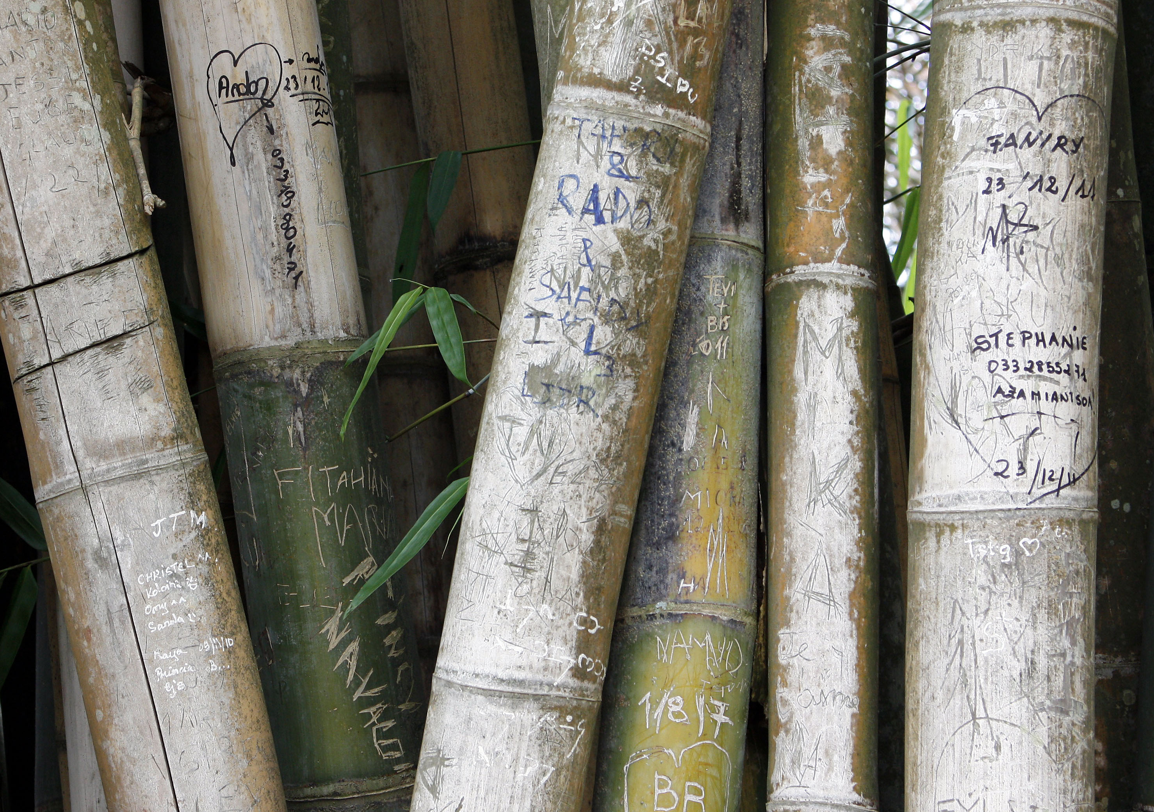
Quality
Soft light.

Slide 32
Quality and mood
Choice of light quality suggests mood.
Hard: drama, power, action, tension.
Soft: calm, peaceful, dull, warmth, sensuality.

Slide 33
Mood
Feelings evoked by an image may depend on:
The quality of light.
The subject photographed.
The attitude of the viewer.

Slide 34
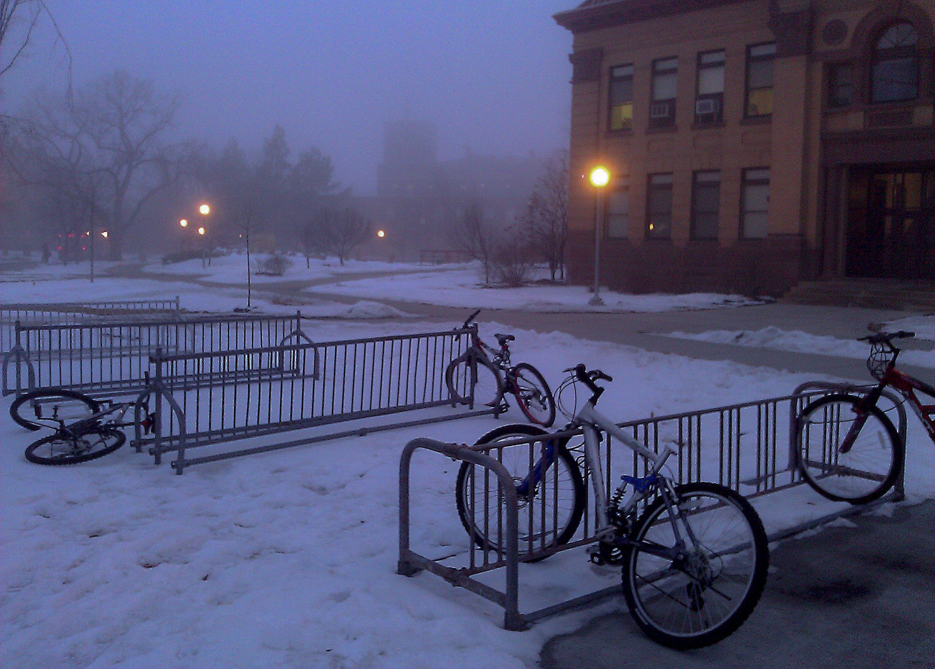
Mood
Soft light

Slide 35
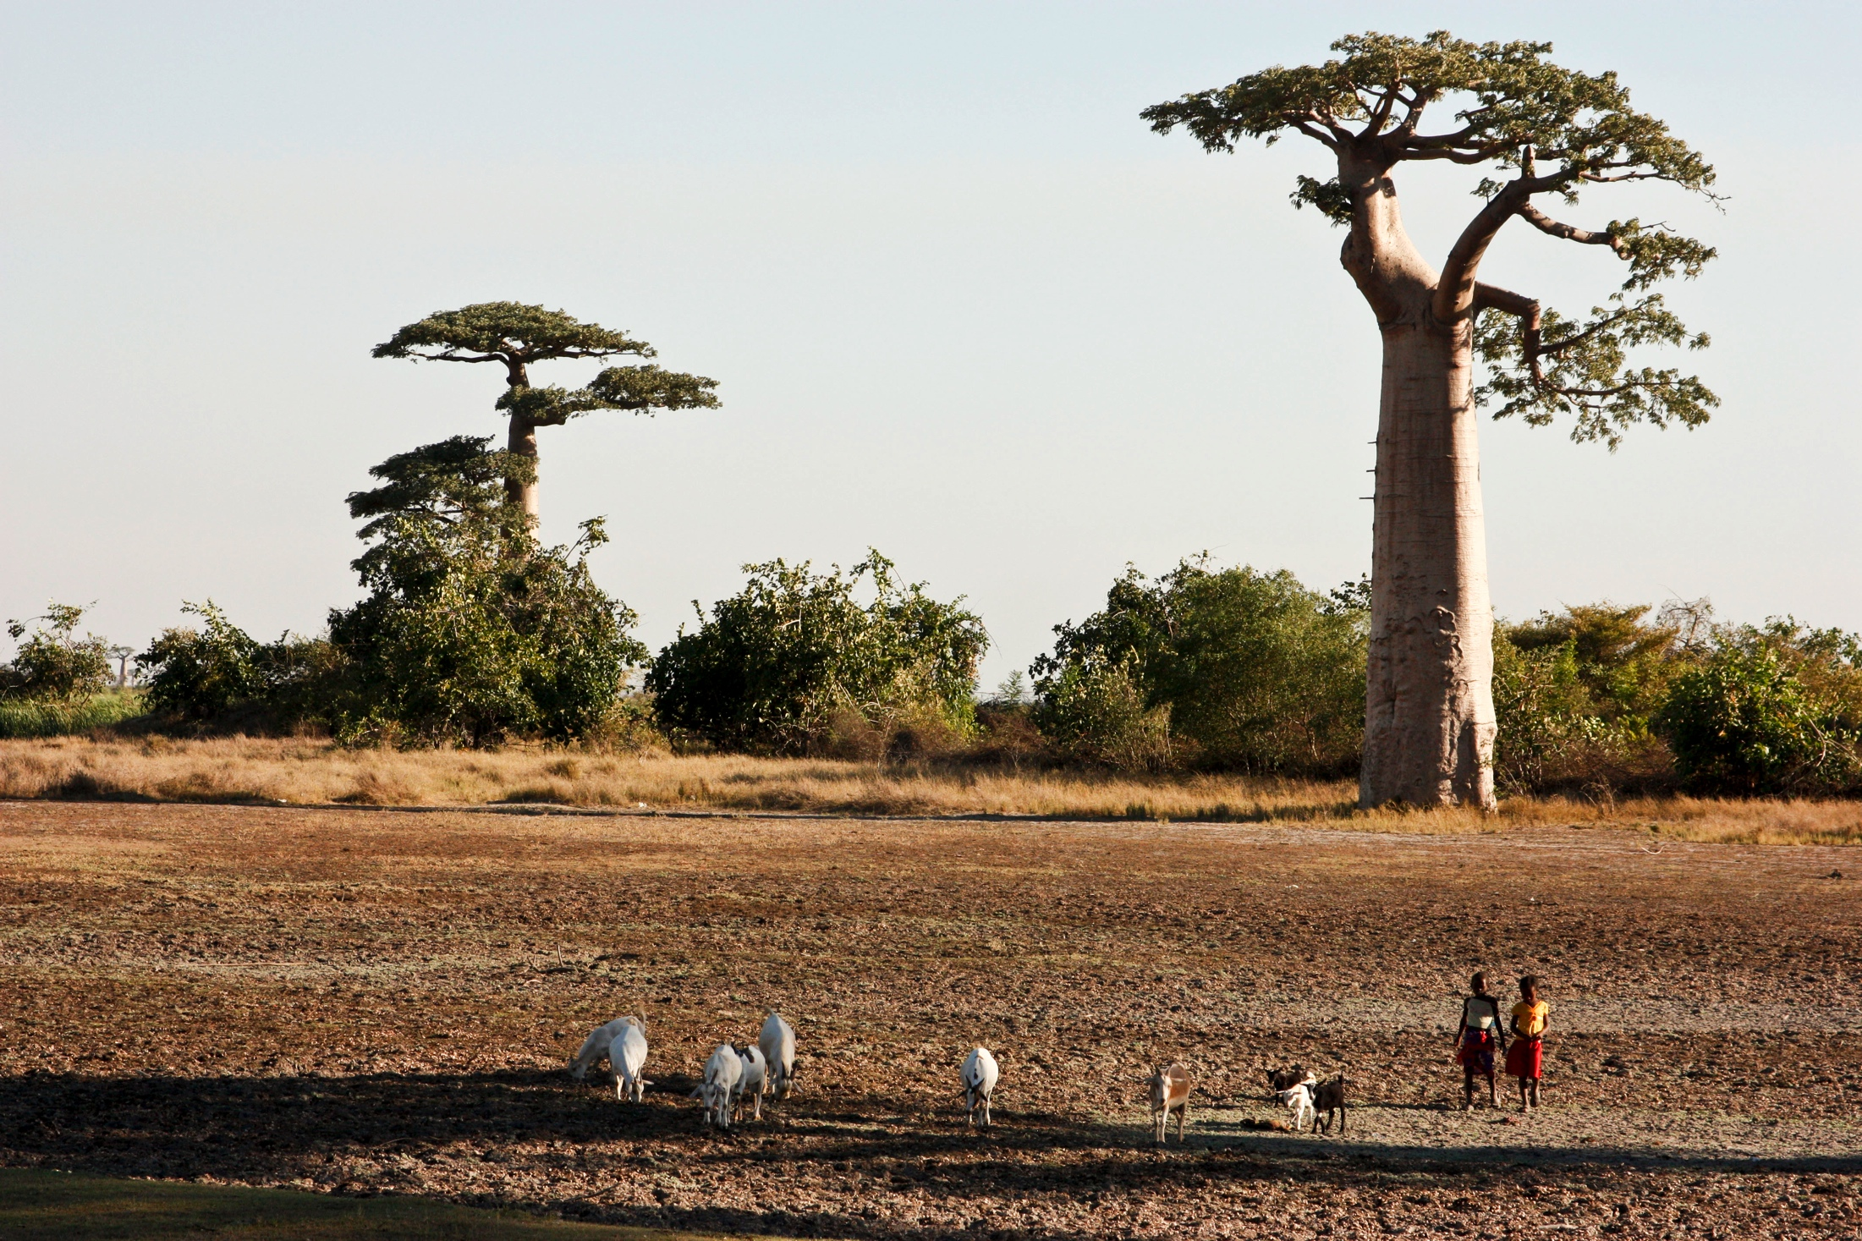
Mood
Hard light.

Slide 36
Direction
Direction gives shape and texture to a subject.
We can determine direction by looking at shadows. Where do they fall?

Slide 37
Direction
Front lighting: No obvious shadows can be seen, because they all fall behind the subject.
This is common using flash on camera, particularly point-and-shoot cameras.

Slide 38
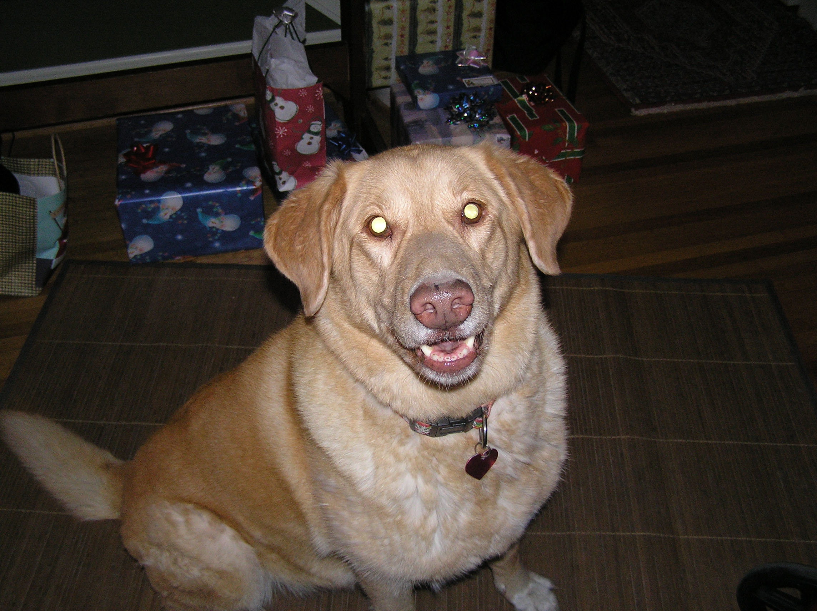
Direction: front
Front lighting gives a flat, two-dimensional feel. It is often considered unflattering or boring.

Slide 39
Direction: side
You begin to see shadows as you move a light away from the camera.
This gives a more three-dimensional field.
It also gives more texture to the subject.

Slide 40
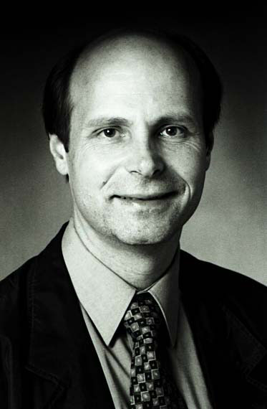
Direction: side
If you move a light to 45 degrees to the side, and 45 degrees above a subject, you reach an angle commonly used in portraiture.
This is called Rembrandt lighting. Note the triangle of light spilling across the cheek.

Slide 41
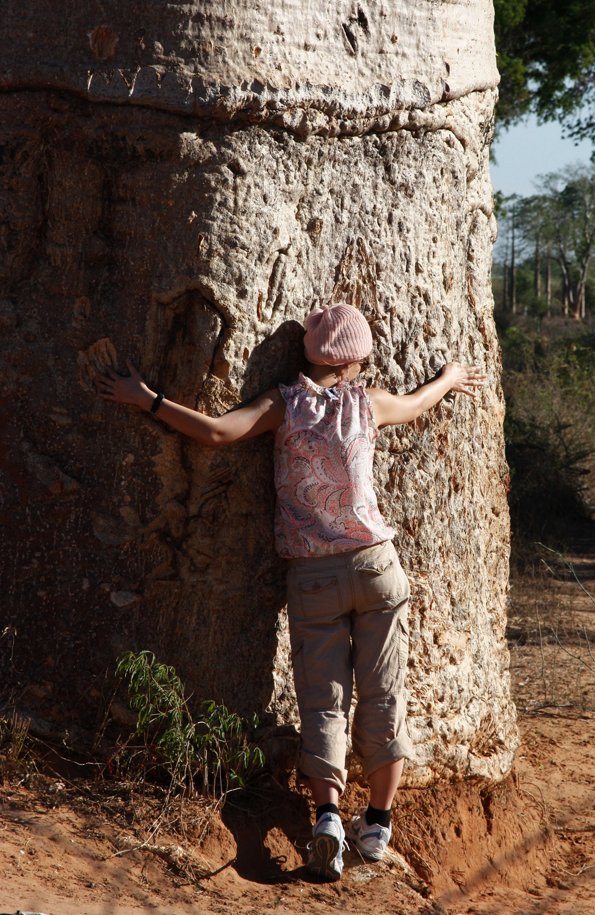
Direction: side
Light coming directly from the side emphasizes texture, and is sometimes called texture lighting.
If hard light, it accentuates flaws, so is not usually used for portraits.

Slide 42
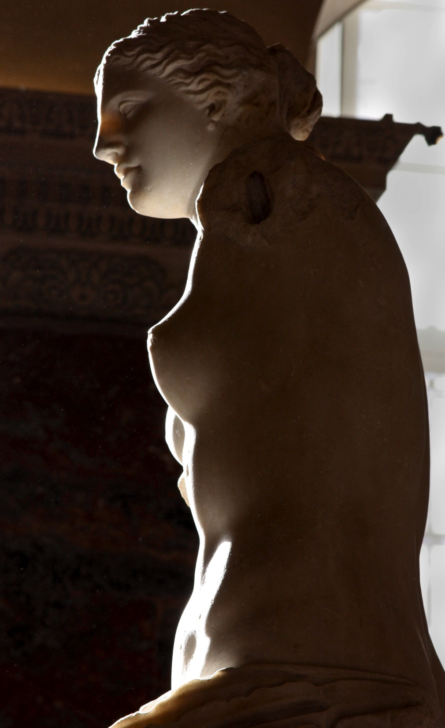
Direction: behind
Light coming from directly behind is sometimes called rim lighting.
This backlighting leaves a halo around a subject, and a silhouette.
The silhouette can be lit, or filled, with secondary lighting from the front.

Slide 43
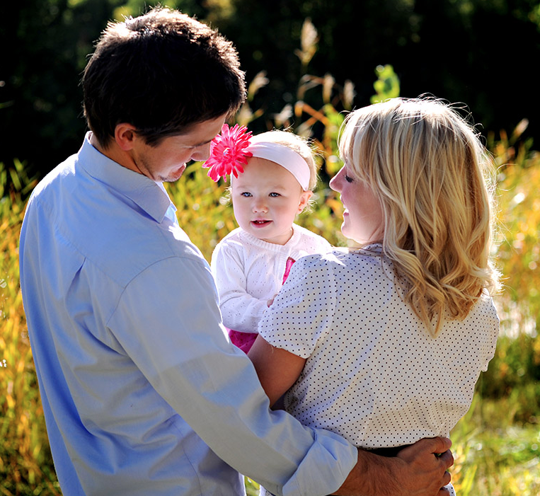
Direction: behind
Professional photographers like to shoot early in the morning or late in the afternoon to add drama by rim lighting effect. But it usually needs some fill.

Slide 44
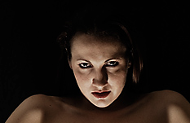
Direction: from below
Light coming from below the subject is sometimes called ghoul lighting.
The reason is that it is unnatural. We seldom see light coming from below. So it takes on a sinister feeling.

Slide 45

High key light
An image of mostly whites or light colors is called high key.
It affects mood, emphasizing delicacy, innocence, goodness, warmth.

Slide 46
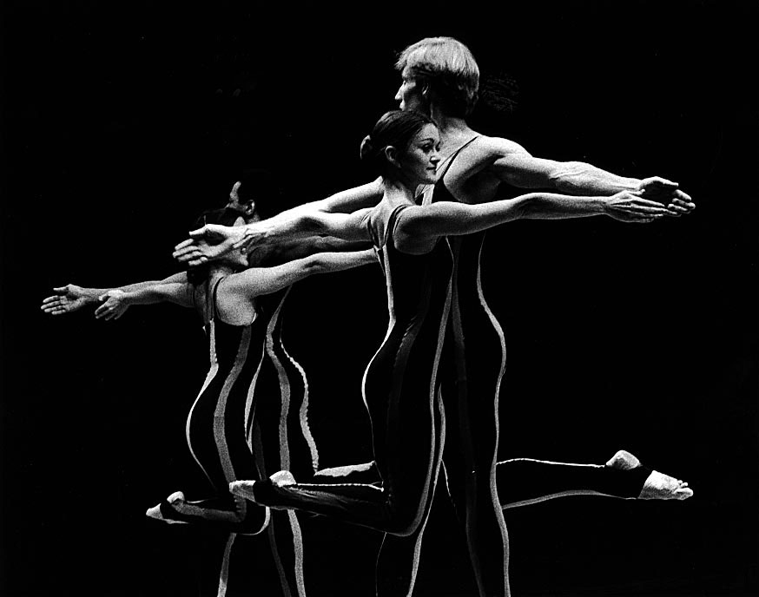
Low key light
Low key lighting emphasizes dark colors and blacks.
It emphasizes mystery, evil darkness, death or seduction.

Slide 47
Texture
One reason we try to avoid flash on camera, or lighting directly in front, is that it does not emphasize texture.
The points of light and dark in photography sets a pattern.
We tell viewers about objects by emphasizing this pattern.

Slide 48
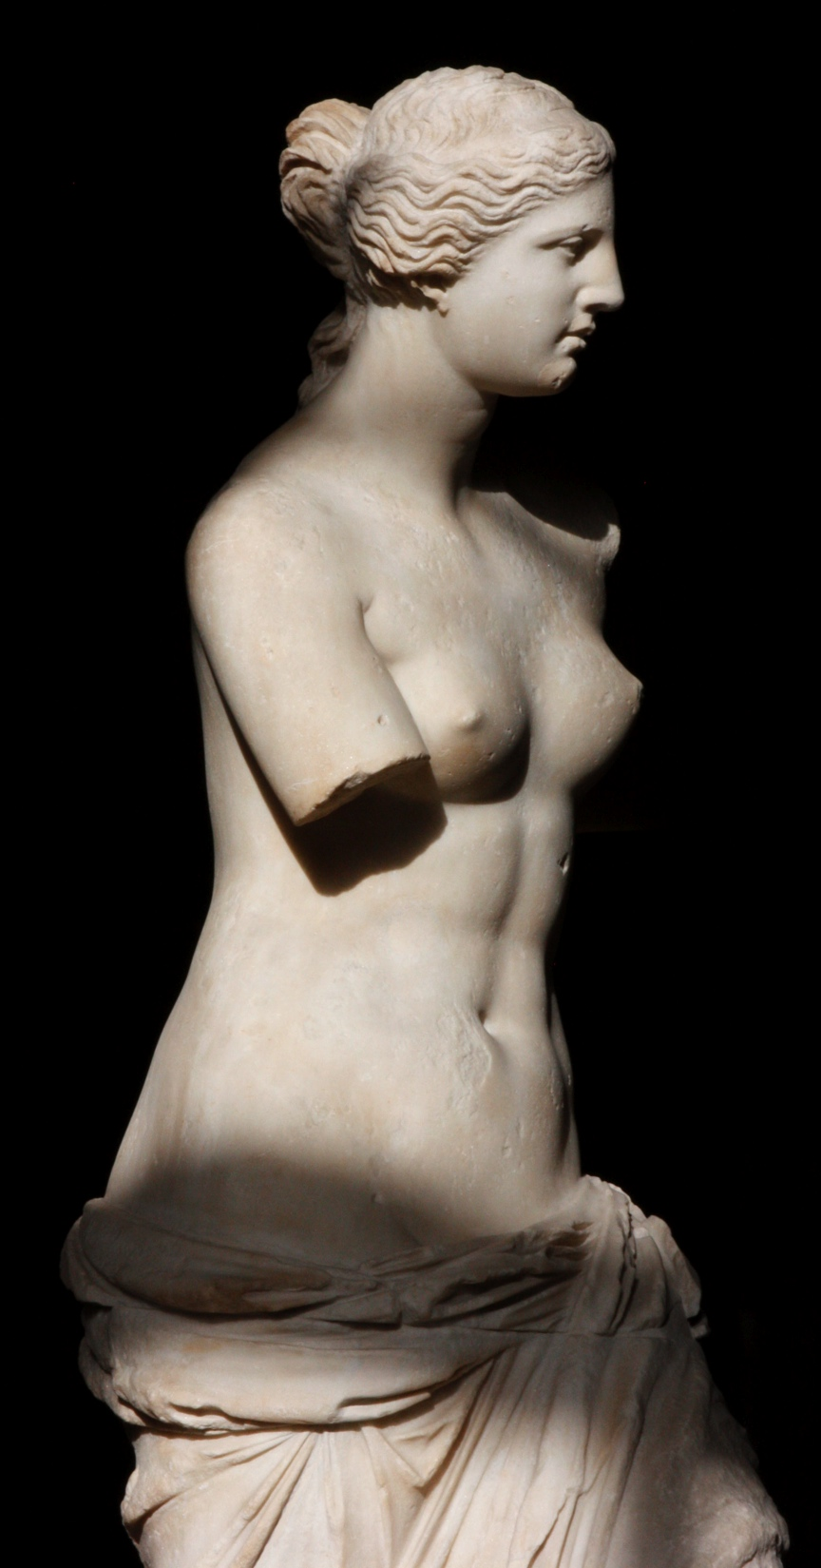
Texture: smooth
Here texture light tells us the object is smooth.

Slide 49
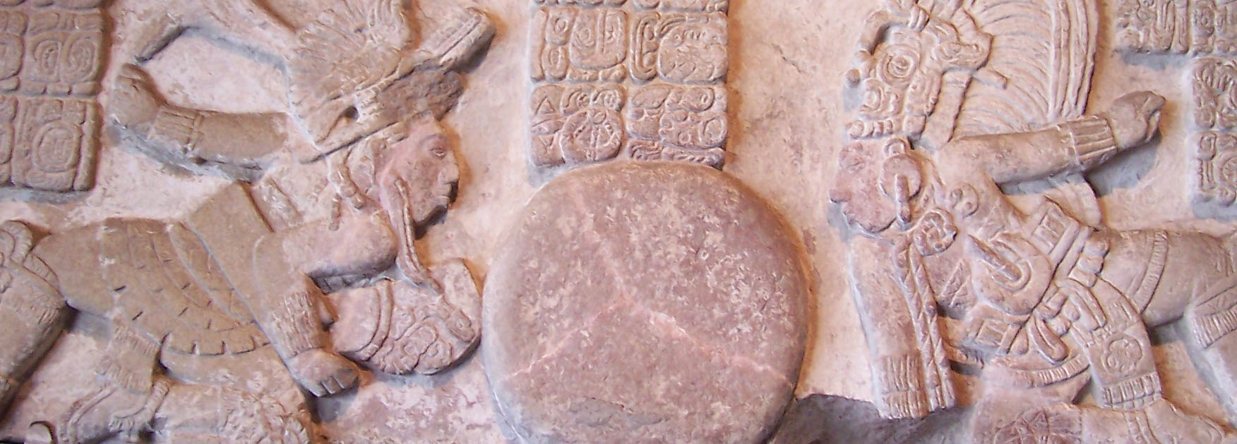
Texture: rough
Here texture light tells us the object is rough.

Slide 50
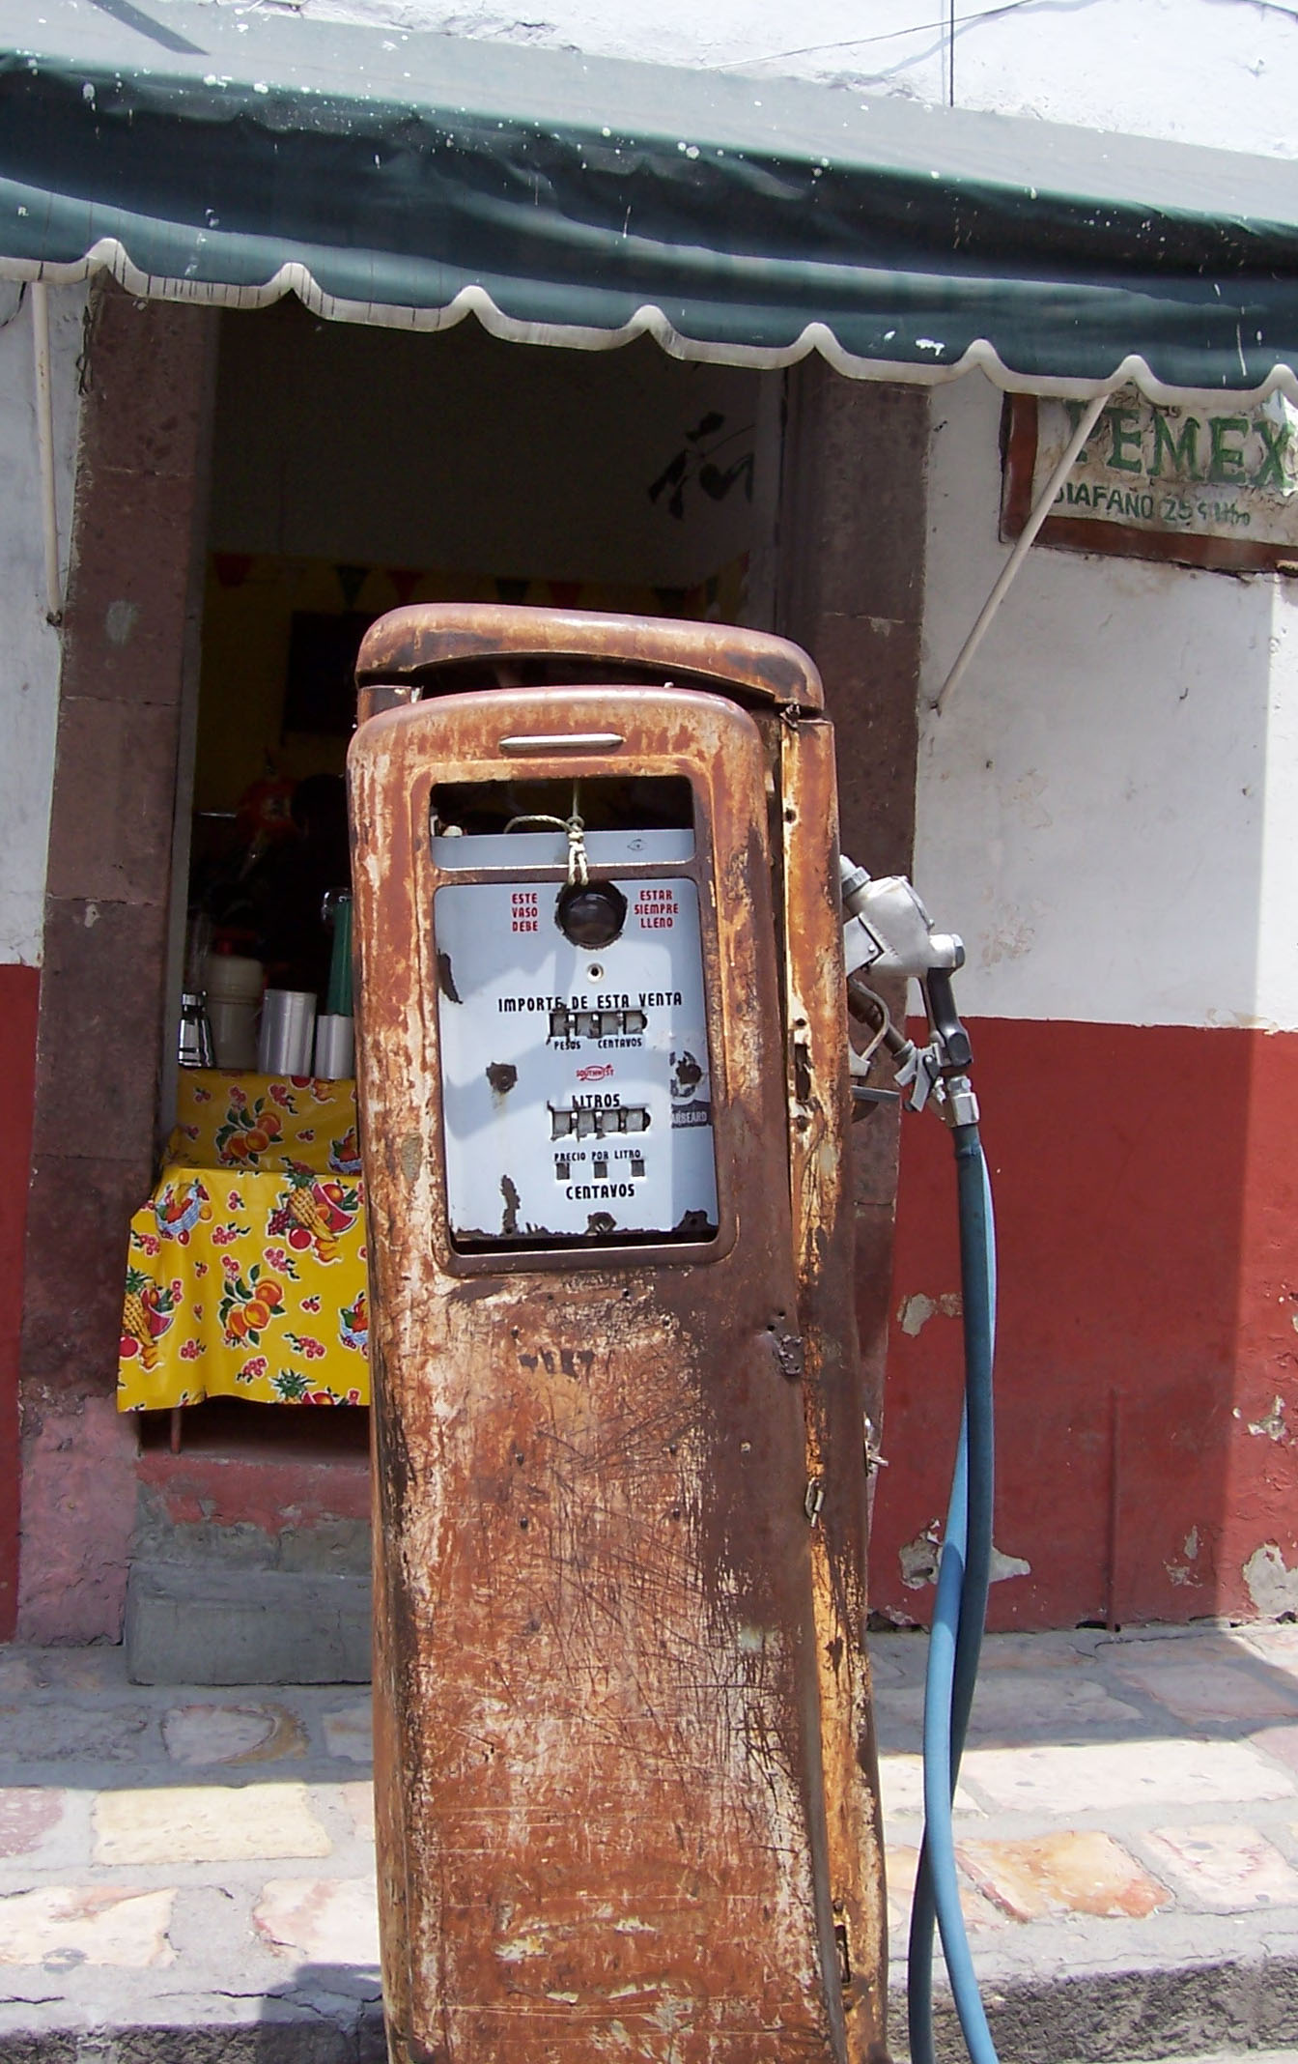
Texture and mood
Texture with color helps to create mood.
We try to combine light directions in a scene, but allow one to dominate.

Slide 51
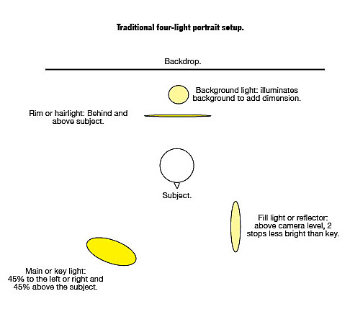
Formal lighting
Traditional portrait lighting uses four lights.

Slide 52
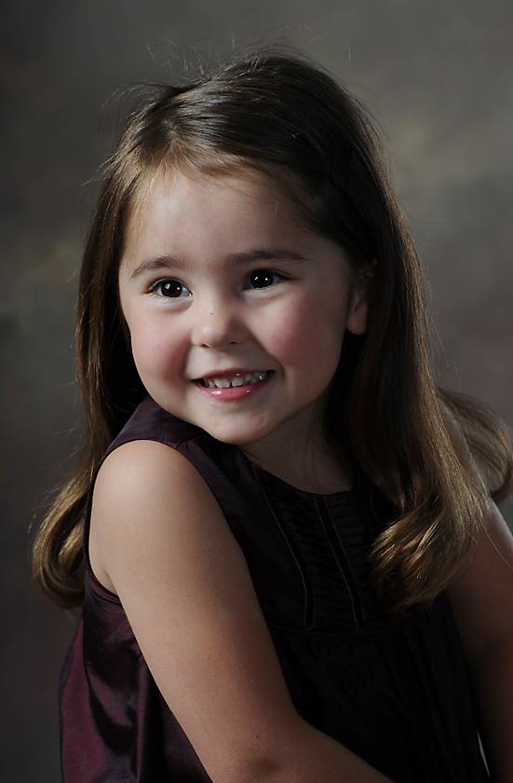
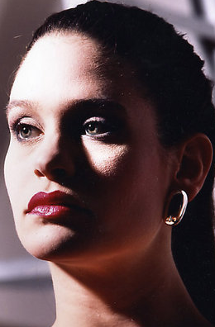
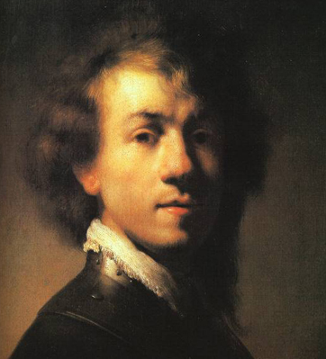
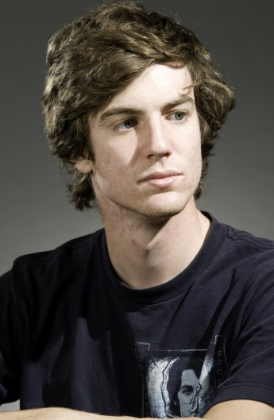
Formal lighting
This is known as Rembrandt lighting. It’s common in all sorts of portraits.

Slide 53
Rembrandt lighting
High-key lighting features almost no shadows. Low-key features strong contrast. Note the triangle of light on the cheek, characteristic of this lighting style.

Slide 54
Taking it outside
Most of us won’t be setting up lights like this for photojournalism.
But we can find lighting similar to the classic Rembrandt by looking at ambient light around us.

Slide 55
Ambient Rembrandt
Most lighting in the real world comes from more than one source—just as Rembrandt lighting. The source may be a reflection, such as florescent light off white tables to fill shadows.
Most ambient lighting includes the strongest light from above. The “key” light is in effect that light.

Slide 56
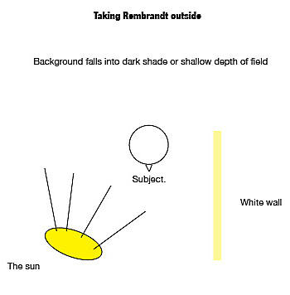
Ambient Rembrandt
Most basic camera guides tell you to shoot on a sunny day with the sun over your shoulder.
This is in effect Rembrandt lighting.

Slide 57
Ambient Rembrandt
Problems with this approach:
The sun is intense, leaving deep shadows.
Fill light is generally inadequate, or impossible to arrange.
Usually no rim light is available to delineate the subject from the background to emphasize dimension.

Slide 58
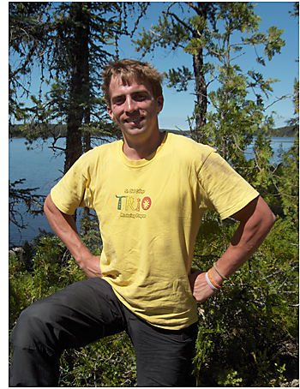
Ambient Rembrandt
This is typical of “sunlight Rembrandt”: deeply shaded eye sockets. Unattractive.

Slide 59
Ambient Rembrandt
The effect is generally the same under florescent lighting, although desks can provide some fill.
Many photojournalists add light to an office scene using a flash bounced off a ceiling, or off a piece of white cardboard.
Some photographers take foldable white reflectors to add fill light inside or outside.

Slide 60
Fill flash outside
An easier option is to rely on your flash to fill the harsh shadows.
Set it to one or two stops less light than your meter indicates. This will avoid having your flash overpower natural light and give an artificial look to your scene.

Slide 61
Fill flash
Most photographers, however, avoid the harsh midday sun. Even with fill light, it’s hard to overcome the power of sunlight.
Some try to photograph only in the morning or evening, when the light angle is lower, and the light is softer.

Slide 62
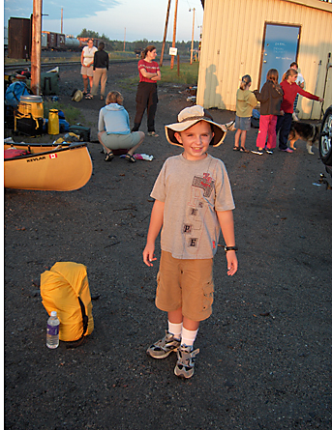
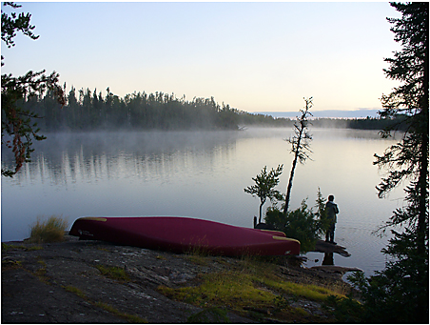
Ambient light choices
At dawn or dusk it’s hard to take a bad picture.
But its soft quality does not show texture well.

Slide 63
Fill light in shadows
If you can’t get out early or late, you can avoid harsh sun by seeking shady areas.
Often, however, you’ll have to add fill, because faces will be too dark.

Slide 64
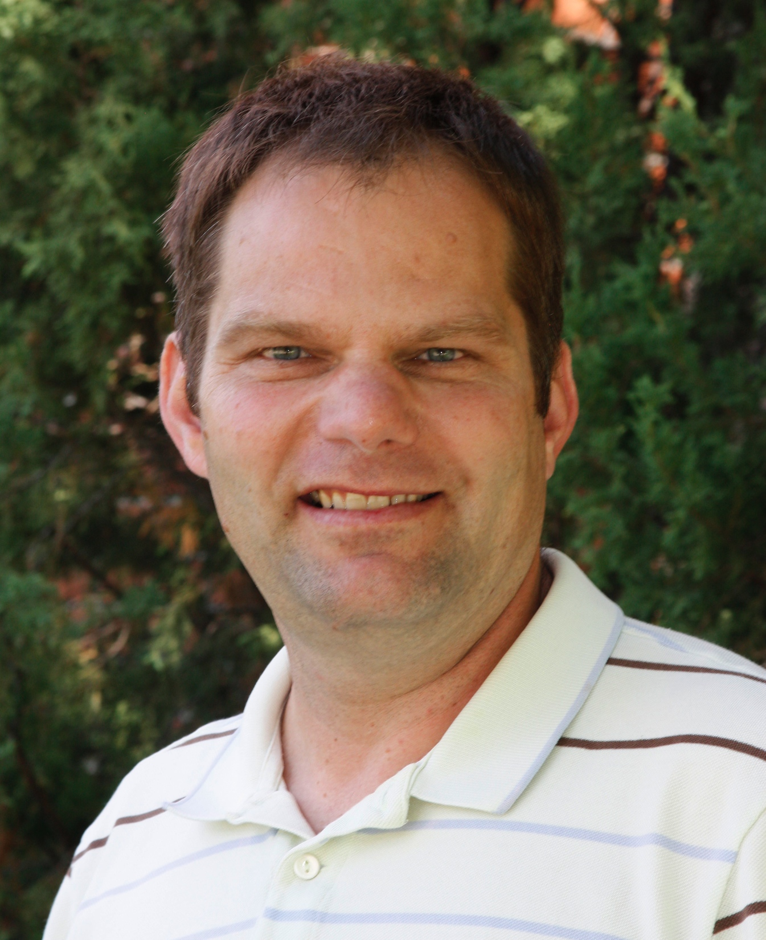
Filling the shadows
In this series of department mugshots, I moved to the shade to avoid harsh sun, and tried a large f/stop to blur the background.
But I still added a little fill light from my camera flash.
I underexposed the flash by one stop.

Slide 65
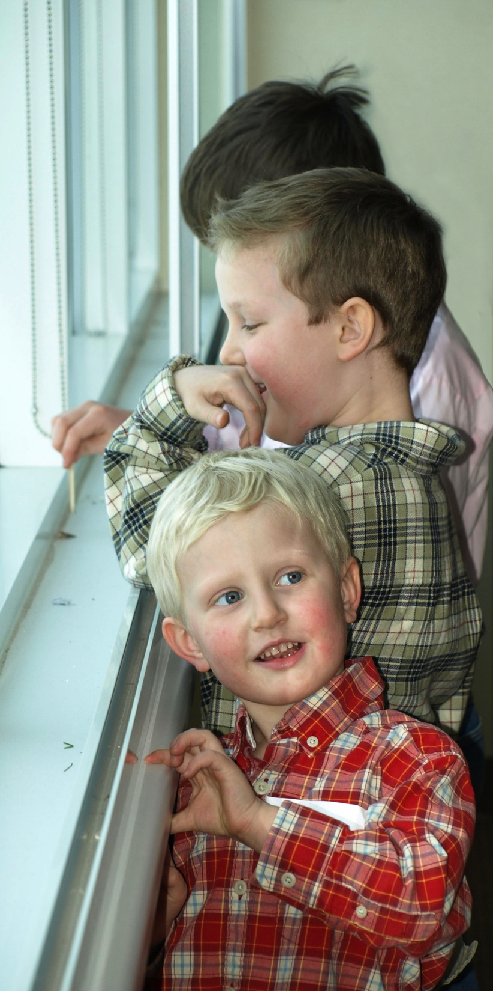
Fill light inside
Often we need fill light inside as well.
Window light can be soft, but also can be harsh. Add a reflector or fill flash.
The fill flash in this photo is a little too harsh for me—the shadows behind the foreground face are deep and sharp. But it’s pretty good.

Slide 66
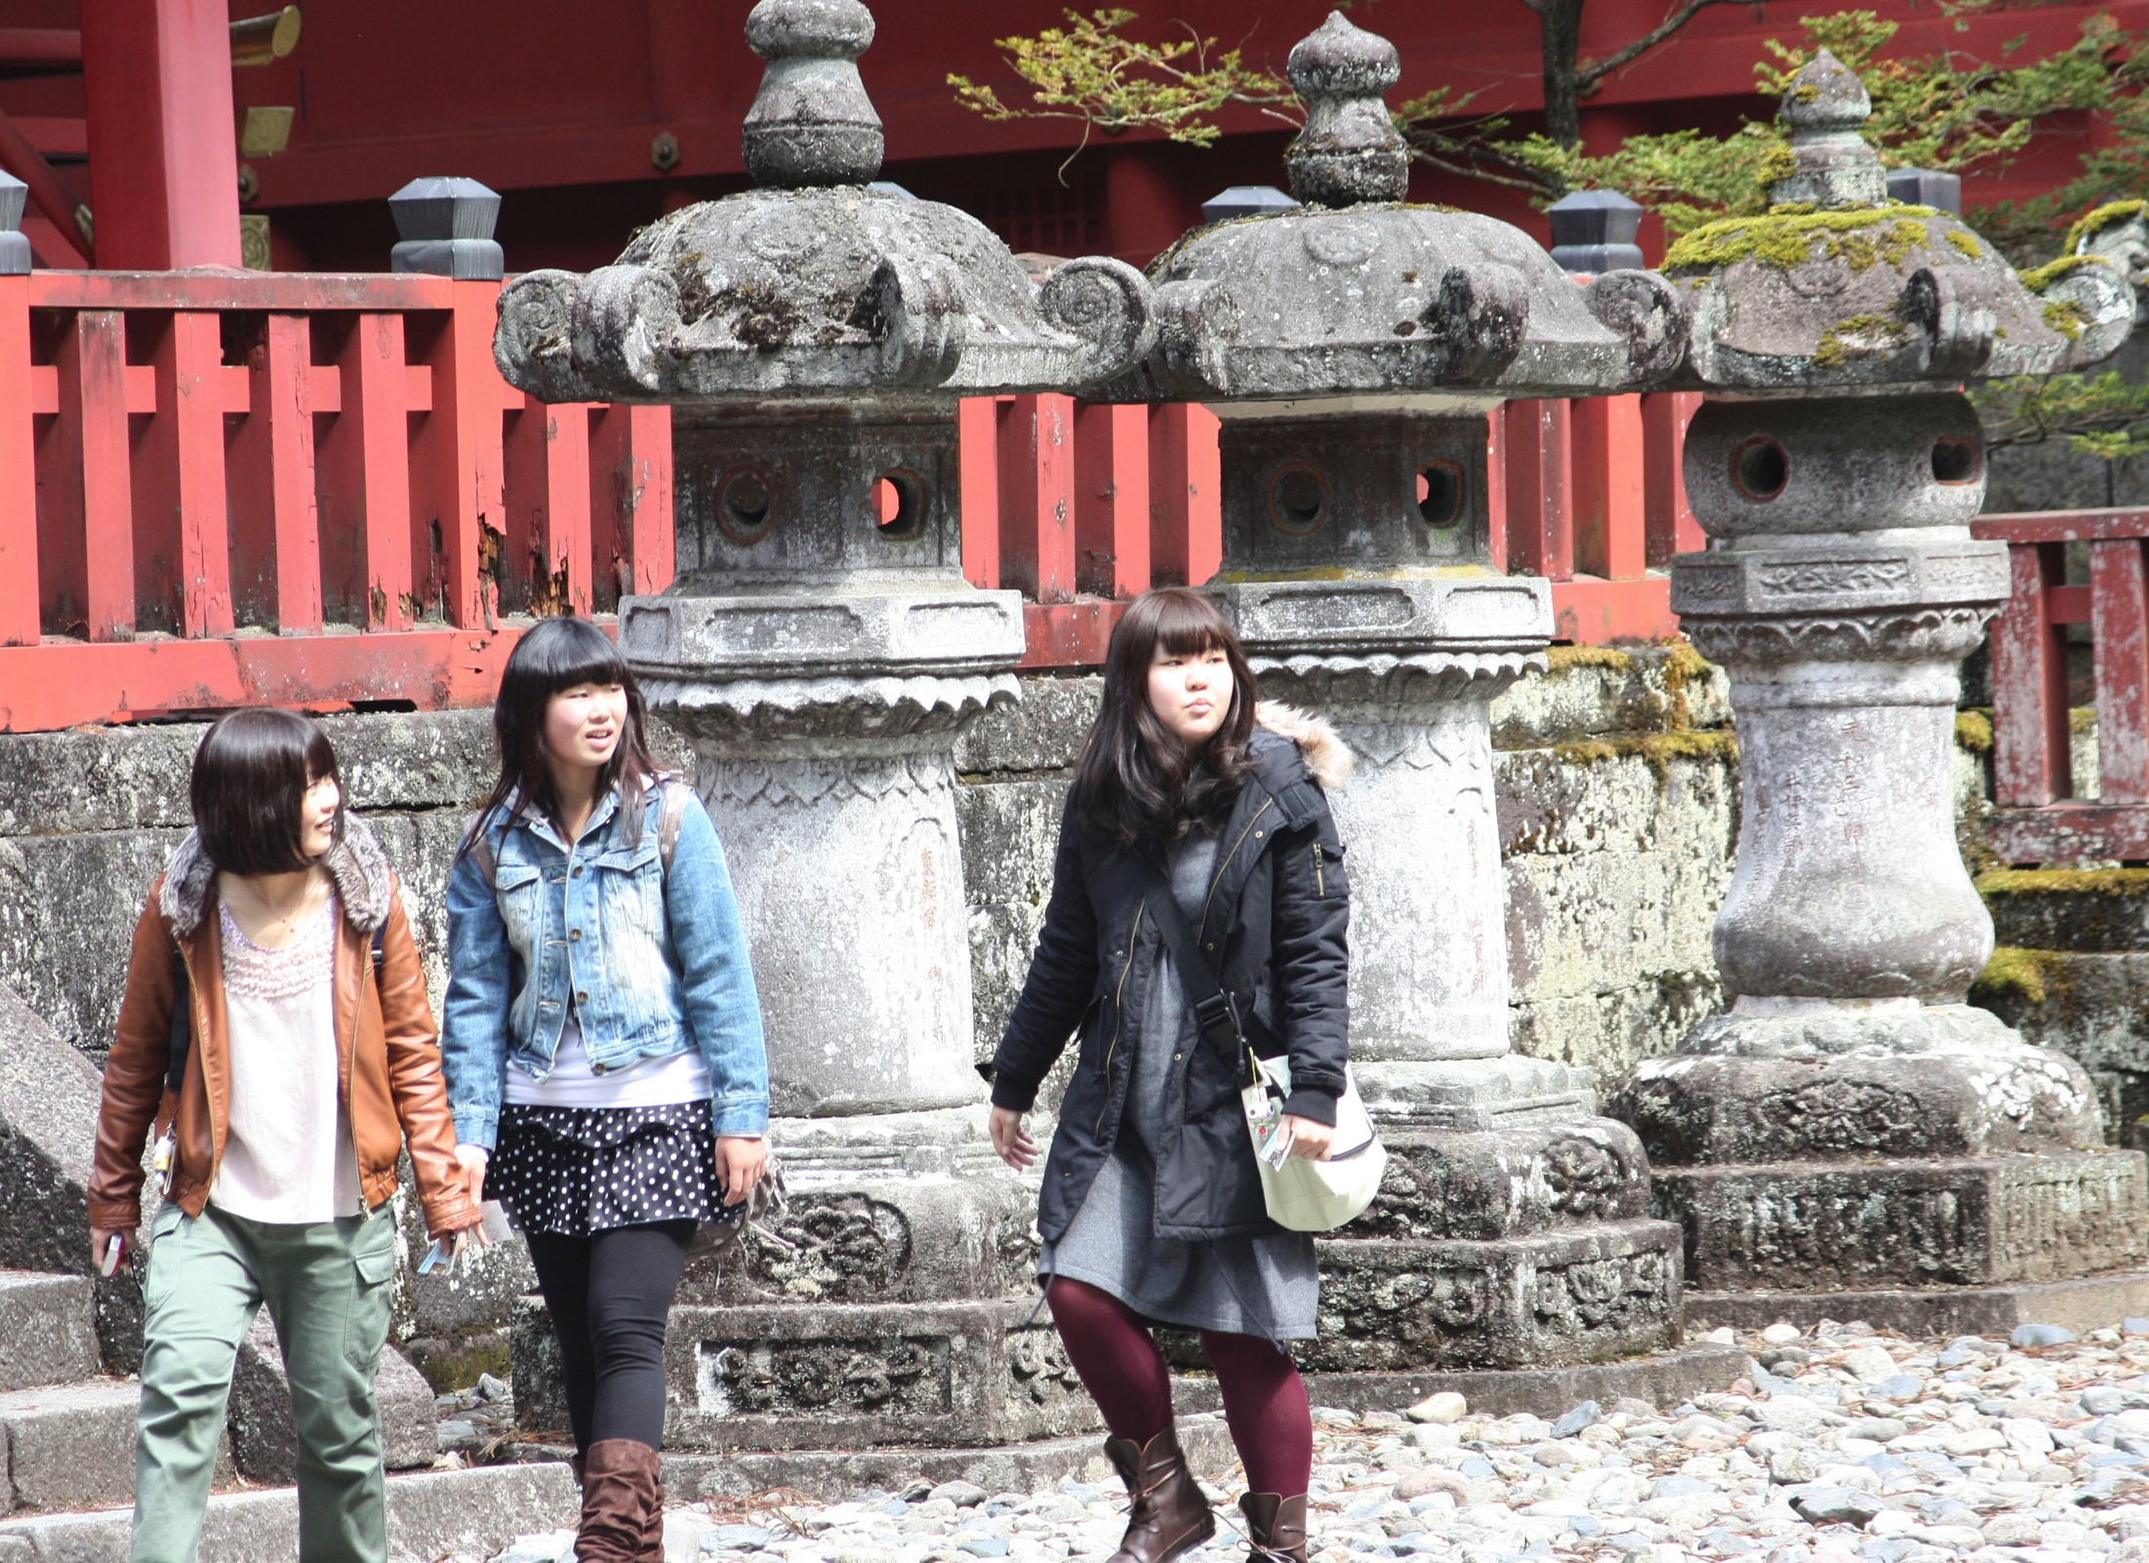
Overcast light
Because sunlight in the middle of the day is so difficult, we often wait for an overcast day to shoot outside.
The light is more foregiving, and we can more easily get detail into shadow areas.

Slide 67
Overcast
But the soft light of overcast days also does not emphasize interesting textures or shadows.
Colors are desaturated.
Some work in Photoshop will help, but you can’t make a software picture you haven’t taken with a camera.
Sports on overcast days becomes difficult, because you need a fast shutter speed.

Slide 68
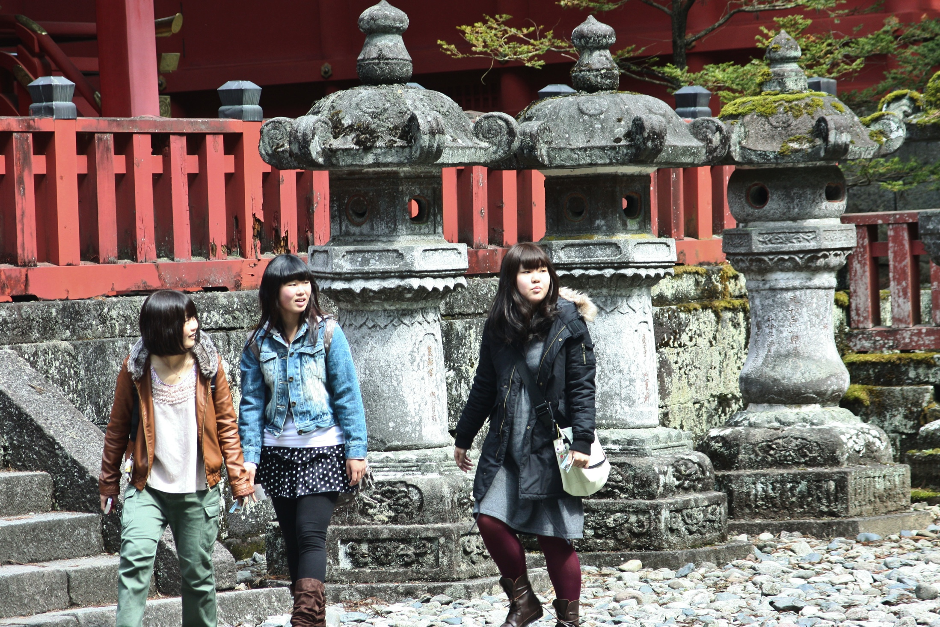
Improving overcast days
Here’s some improvement.

Slide 69
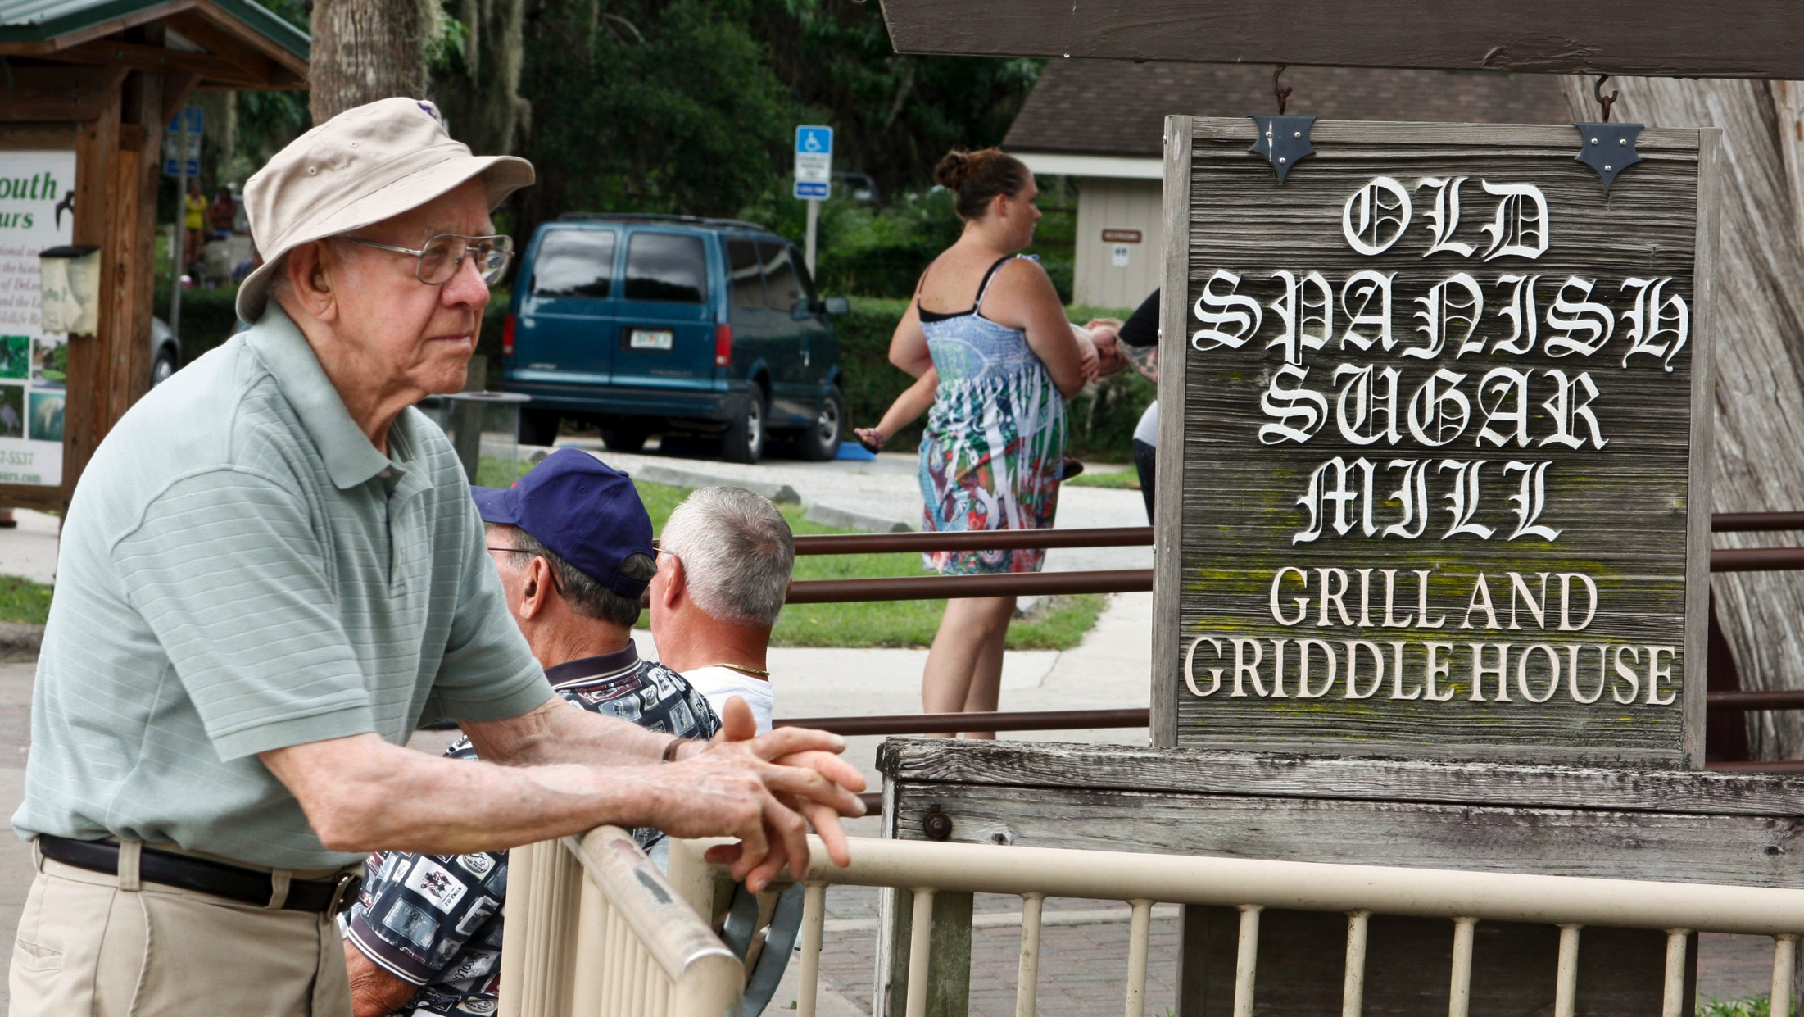
Hazy sun
Best bet for daytime photos outside is wait for the lightly overcast, but still bright, day.

Slide 70
Flash
So from this discussion we can presume that advanced photographers seldom use flash the way the rest of us do: based on the pop-up model attached to the camera.
Instead, we can use it as a fill light (always set a stop or two underexposed).
Or we can use a separate unit and bounce it off a ceiling or wall.

Slide 71
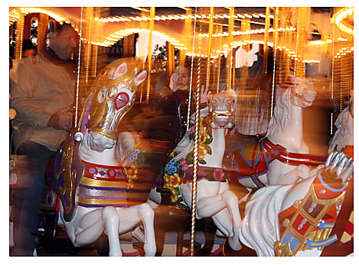
Combining ambient and flash
Sometimes we can combine ambient light and flash to interesting effect.
Below the shutter speed is slow enough to collect light while the flash freezes some of the action.

Slide 72
Desperation: flash on camera
If you must use flash on camera, keep in mind it looks best if the room is fairly bright.
Turn on all the lights you can to add detail to the gloom left by a flash.

Slide 73
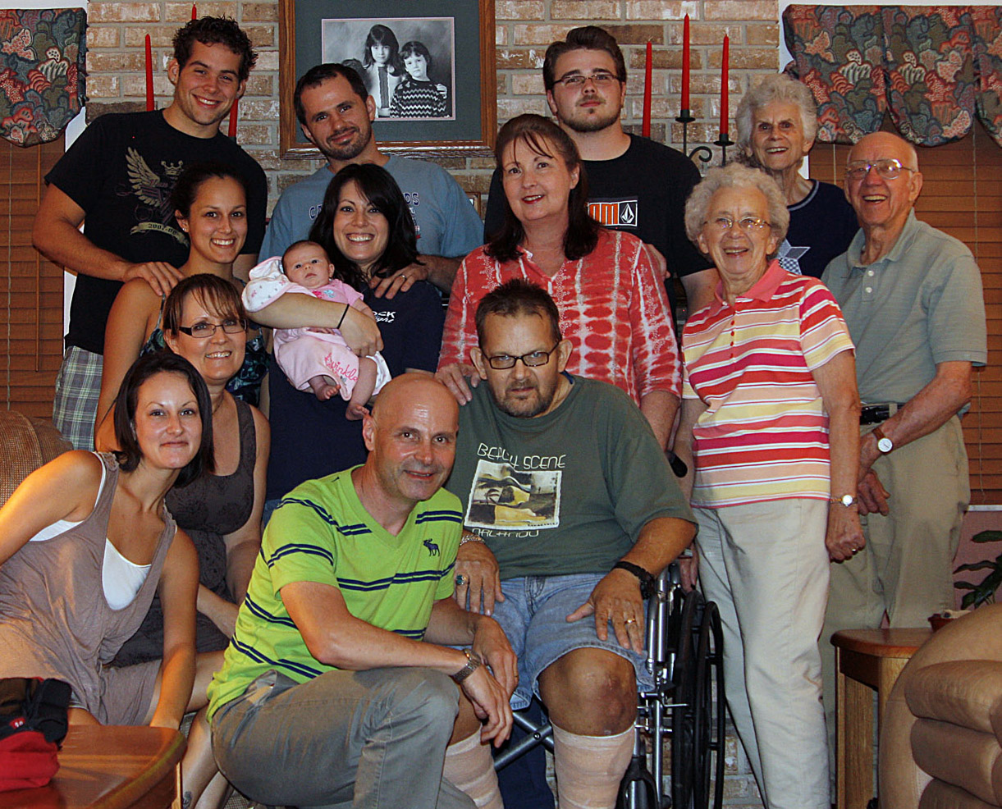
Flash on camera
I did rely on my flash for this self-timed group shot, but the extra light in the room helped somewhat. The flash reflections should be fixed in Photoshop.

Slide 74
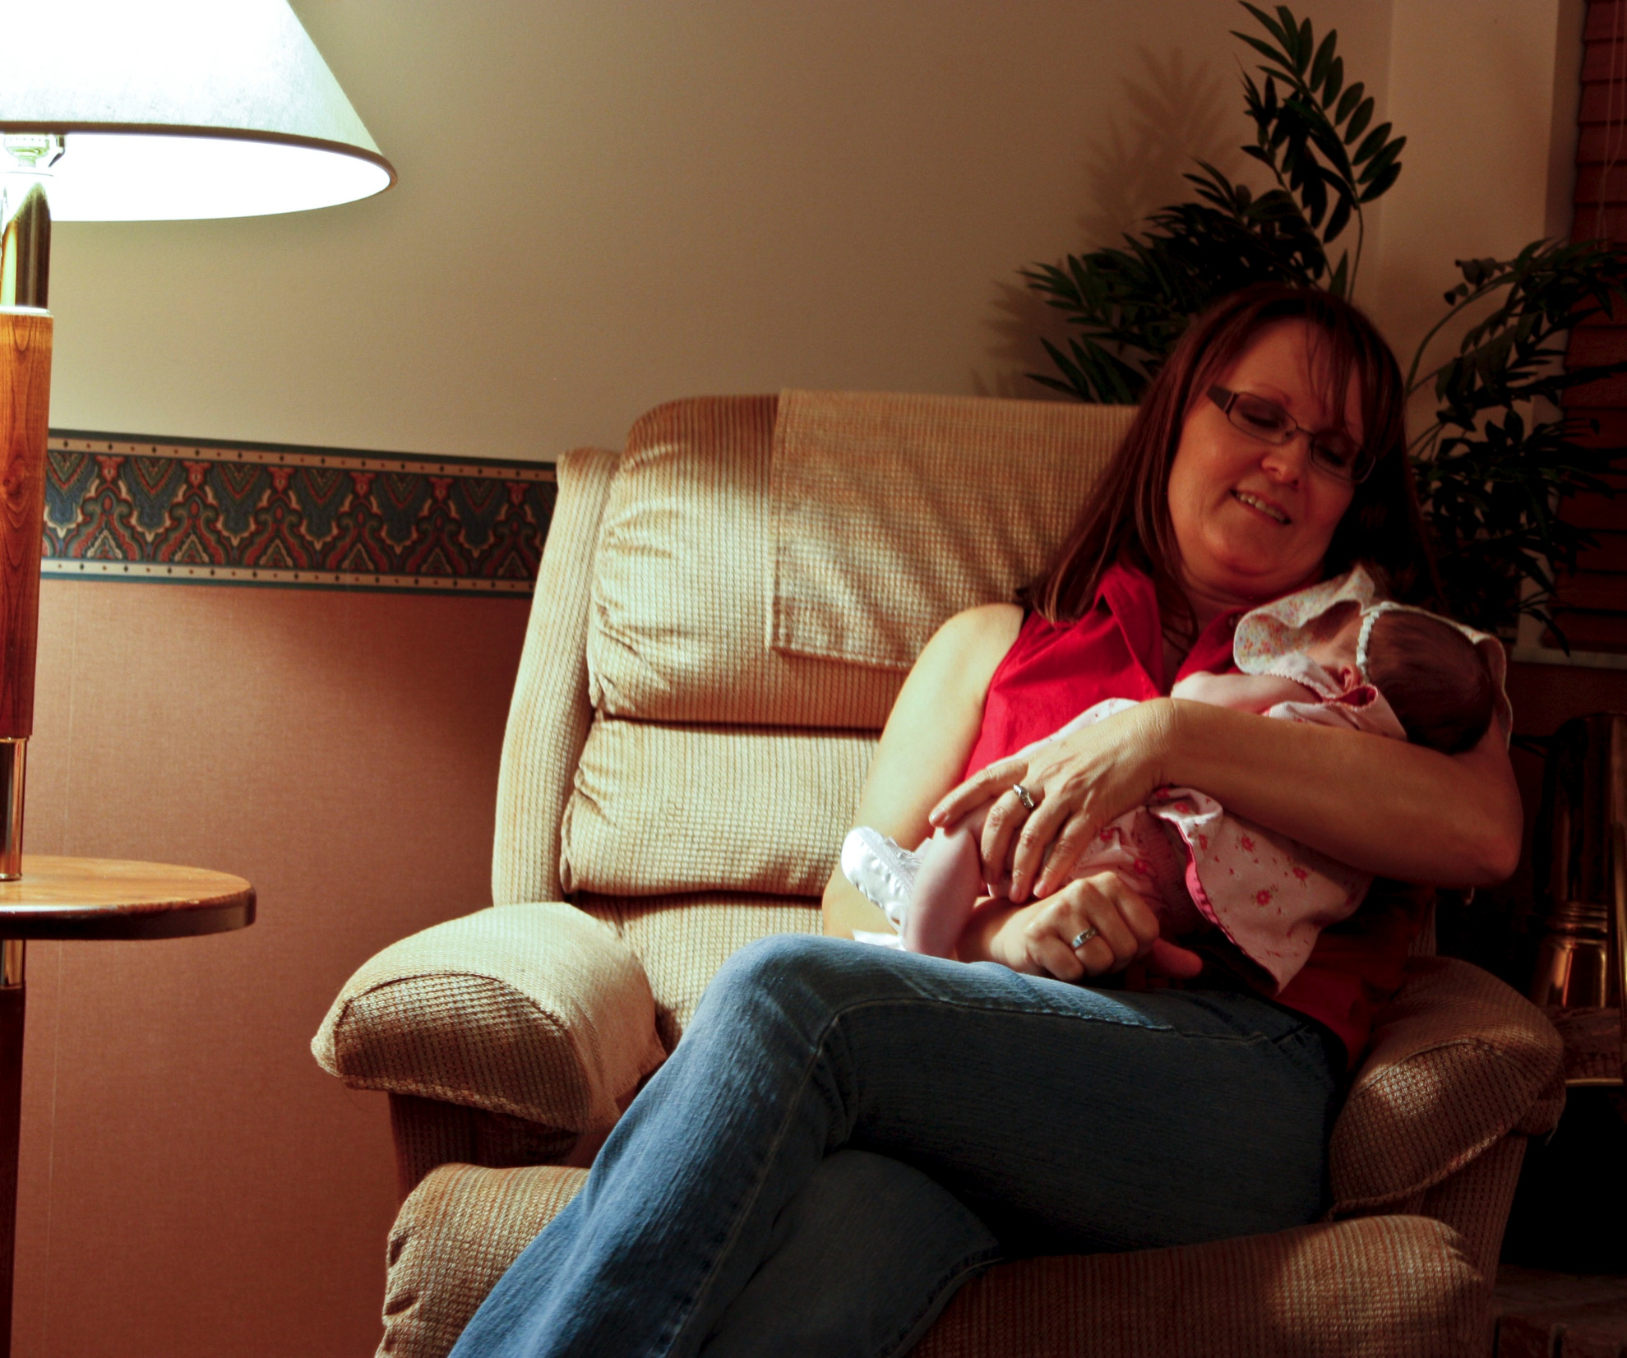
Other light sources
Don’t overlook less common light sources.
I’ve left the lamp in this photo so you can see the light source, incandescent light.

Slide 75
Other light sources
Note the light actually reflects off the opposite wall to help fill shadows.

Slide 76
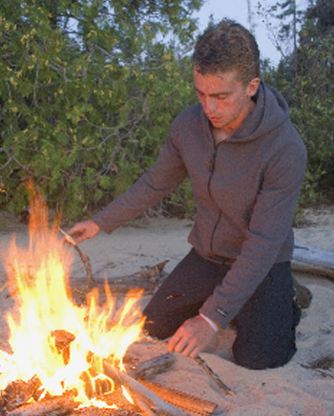
Fire
Here we have a combination of fire light and ambient light at dusk.

Slide 77
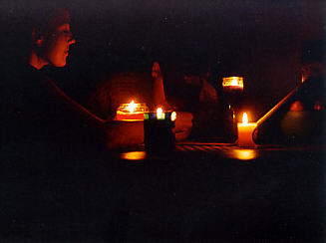
Fire
Or even a candle.
Often this weak intensity needs a little fill.

Slide 78
Weather
People sometimes put their cameras away when the weather gets bad.
But it’s counterintuitive: Sunny midday is the worst time to take pictures. During a storm might be the best.

Slide 79
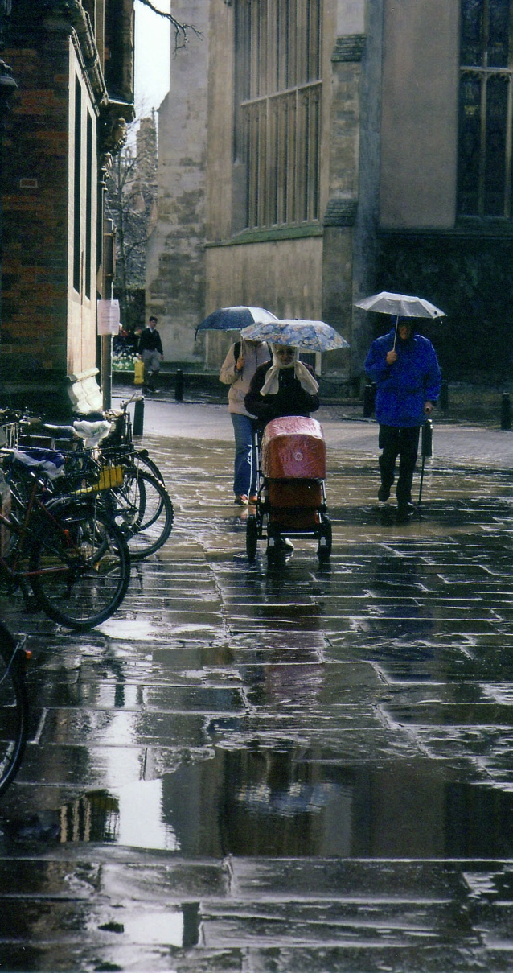
Rain
Rain adds reflections and patterns.

Slide 80
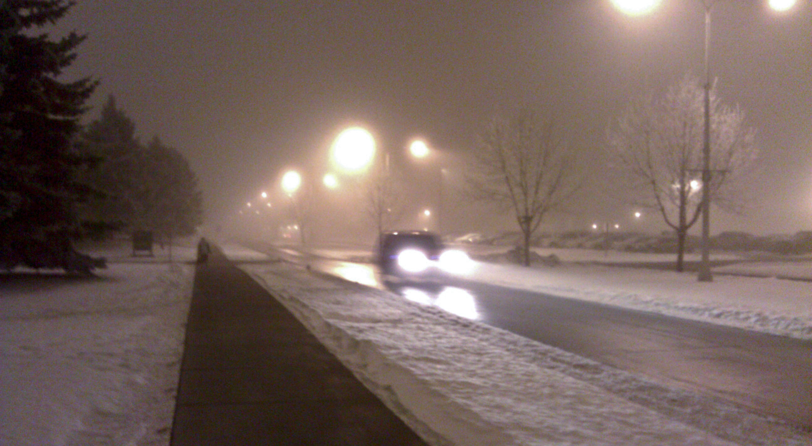
Fog
Fog adds mystery to everyday scenes.

Slide 81
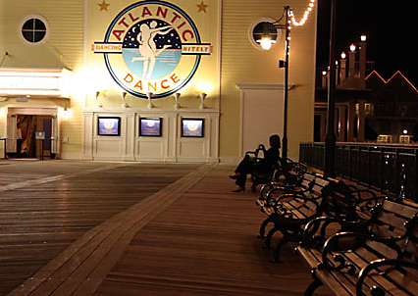
Night
Try a night scene! You often will get more interesting results by underexposing a stop or so.

Slide 82
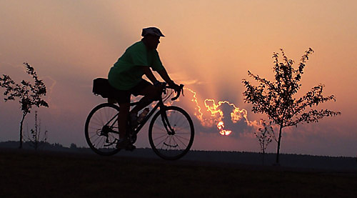
Sunsets
Most editors reject sunsets as cliché, but if you can make it really different, it might work.

